Slide 1
Milestone 1
Wong Yao Hui - 1901868
Ng Jing Kiat - 1901819
Marsius - 1901855

Slide 2
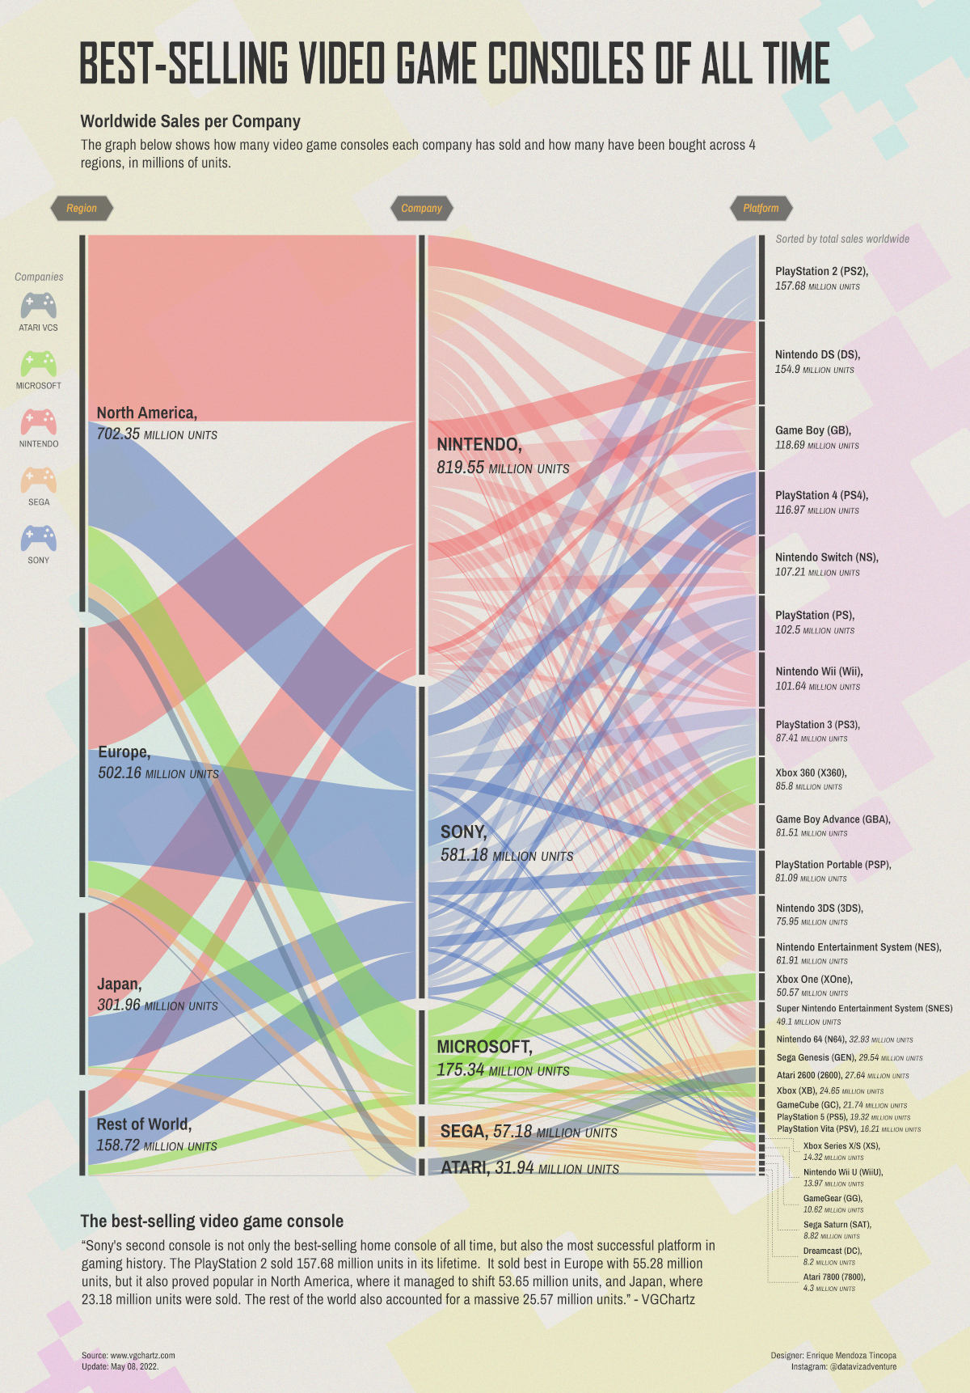
Example 1
This Sankey graph is designed by Enrique Mendoza Tincopa to visualize the best-selling video game consoles based on the worldwide Sales per Company on different regions.
Source: https://www.reddit.com/r/dataisugly/comments/v6mg1u/its_not_that_bad_but_there_is_way_too_much_going/

Slide 3
Example 1:
Criticism

Slide 4
Example 1: Data (What)
The representation of the data on the graph contains too much information and confusing visuals at first glance. Viewers would need to look closely to focus on which wave represent the console and which company it originate from.
There are 3 main datas to be focused on based on the graph, which is the Region, Company, and platform.
Region & Company: Categorical Data
Platform total (Console sold): Quantitative Data

Slide 5
Example 1: Idiom (How)
It uses the thick waves (curves) to illustrate the amount of sales linking the three main categories (Region, Company & Platform) which can be confusing, as the waves are intercepting one another with different colours making it difficult for the user to follow the trend/pattern. The trend or pattern is not obvious from the visualisations to know which region, company or platform has the best sales, etc.
There are too many types of console under the platform category which is splitted according to the black dotted lines, the separation of the types of console is not distinct or space out enough for the users to easily figure out which colour waves falls under which types of console.
The middle section (Company) is unnecessary as the legend already depict the company it belongs to.

Slide 6
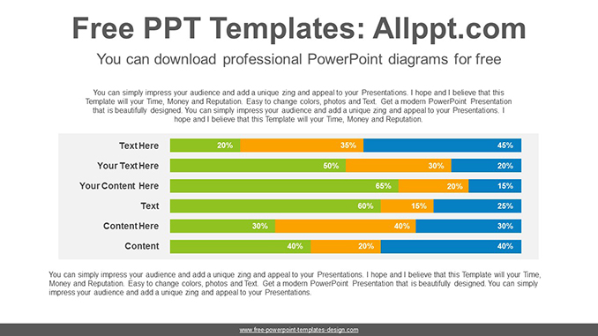
Improvement for example 1
We can represent the datas in a bar chart as shown in the reference.
A drop-down list can allow the viewer to select the company or comparison of all companies.
Consoles will be sorted based on their company
Color can be used to show the region that the console is sold on, and each bar will show the number of console sold in millions.
If doing a comparison, console names will be color coded based on their company to differentiate.

Slide 7
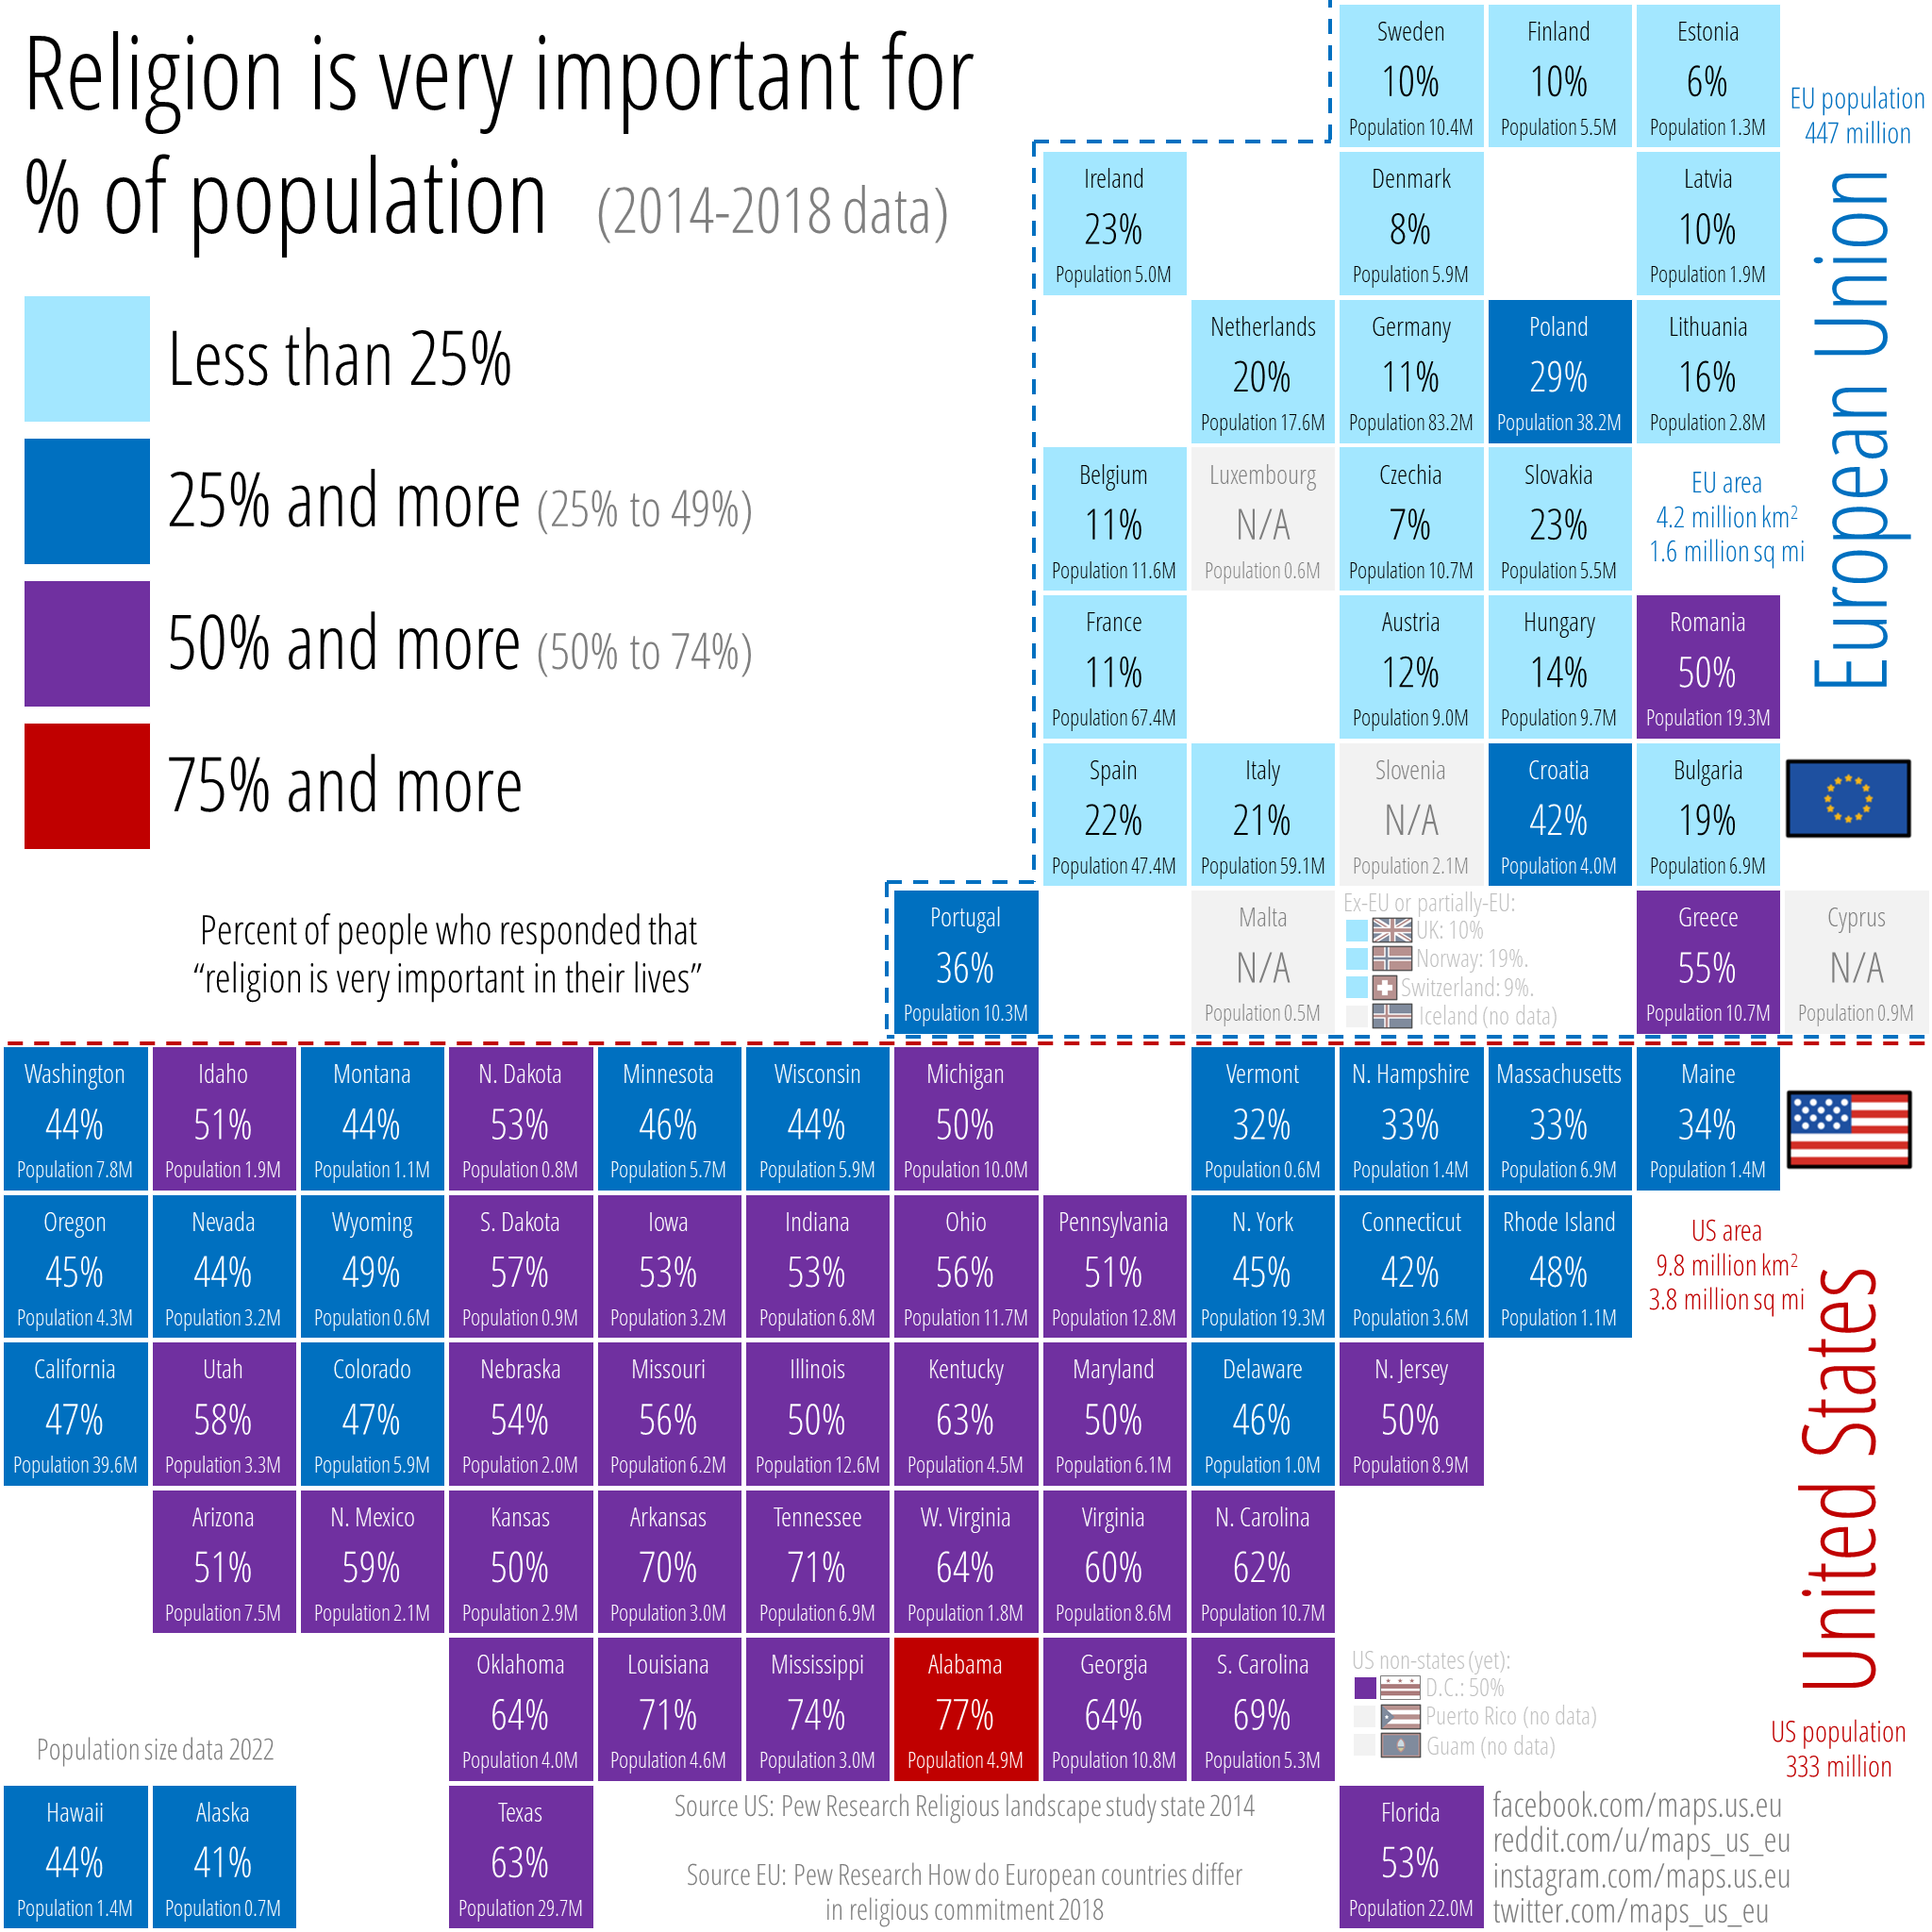
Example 2
This graph is designed by user, maps_us_eu, to visualize the importance of religion for the population between the United States and European Union.
Source: https://www.reddit.com/r/dataisbeautiful/comments/vfrqow/percent_of_people_who_responded_that_religion_is/

Slide 8
Example 2:
Criticism

Slide 9
Example 2: Data (What)
The data is represented using a block map of the different states in the United states and the different countries in the European Union. This makes it hard to read and find specific states/countries as they all look similar.
The block map also fails to effectively show the population distribution between different states/countries as they are all the same sized blocks.
Notes:
What (data): What is the data about
Not sure to include:
The population data should be excluded or represented in a different graph as it does not fit well with the percentages shown.
Eg. California 47% (39.6M) vs Alabama 77% (4.9M)

Slide 10
Example 2: Idiom (How)
The percentage range used in the legend is quite limited, most of the percentages in the United States are represented by blue and purple.
Also Alabama looks worse than every state in the United States with 77% but Mississippi is only 3% lesser than Alabama.
The colors used in the legend has 3 different dark colors and only 1 light color which makes it harder to judge which color is representing a higher percentage than the others.
Notes:
How is the data being visualized?
ORIGINAL
The visualisation splits the data into two main powers (European Union, United States). The position of the boxes does not have any clear meaning, but it seems to just trying to fit into the same page. It does not show/provide any relationship between nearby countries/states if user does not know if the countries/states are close to one another.
The percentage of the religion is based on the population in each countries/states illustrated by each boxes. There are too many numbers (%) to go through in each boxes, while the anomaly are more significant data that the user may be looking for.

Slide 11
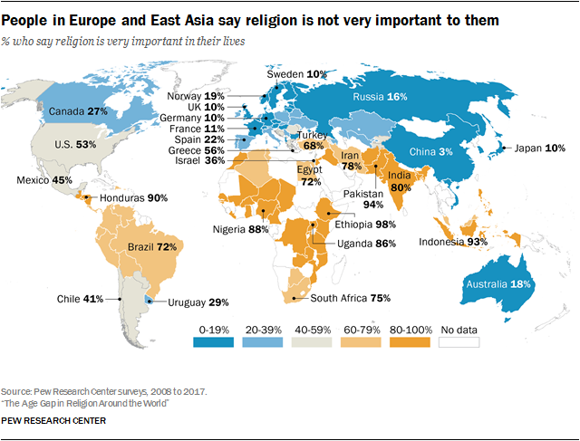
Improvement for example 2
We can represent the data in a heat map.
The higher the percentage the darker the colour will be, and each colour will represent either the European Union or United States.
When hovering over the countries/states in the map, the percentage can be shown to user.
Source: https://www.pewresearch.org/religion/2018/06/13/how-religious-commitment-varies-by-country-among-people-of-all-ages/

Slide 12
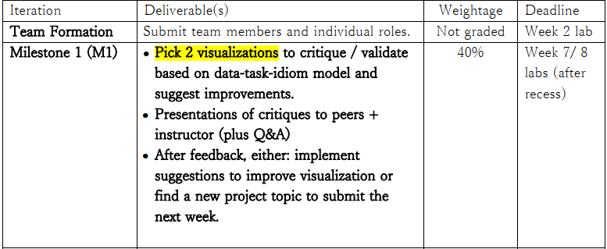

Slide 13
